Slide 1
Flow Description Attributes GUI
Edgar Padilla

Slide 2
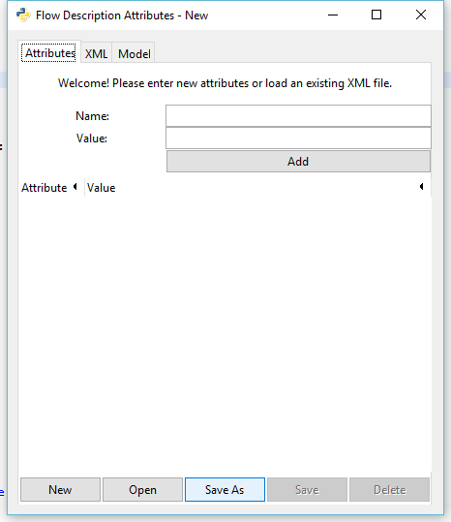
Attributes Tab - New
You can start a new presentation or clear content for a new one.
Notes:
How presentation will benefit audience: Adult learners are more interested in a subject if they know how or why it is important to them.
Presenter’s level of expertise in the subject: Briefly state your credentials in this area, or explain why participants should listen to you.

Slide 3
Attributes Tab - Open
Open attributes from an existing XML file
Notes:
How presentation will benefit audience: Adult learners are more interested in a subject if they know how or why it is important to them.
Presenter’s level of expertise in the subject: Briefly state your credentials in this area, or explain why participants should listen to you.

Slide 4
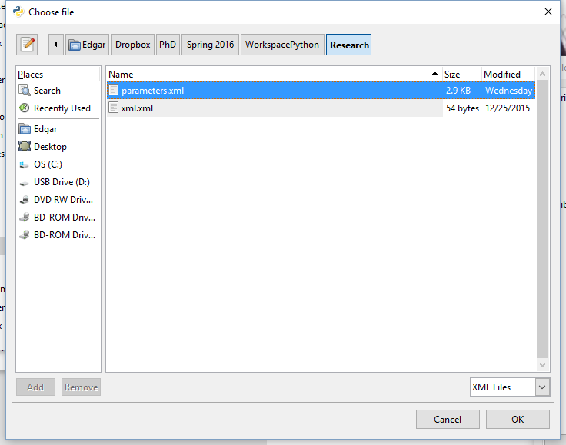
Attributes Tab - Open
When shown the dialog box select xml from the drop down box
Notes:
How presentation will benefit audience: Adult learners are more interested in a subject if they know how or why it is important to them.
Presenter’s level of expertise in the subject: Briefly state your credentials in this area, or explain why participants should listen to you.

Slide 5
Attributes Tab - Open
When shown the dialog box select xml from the drop down box
Then, select the file to be loaded
Notes:
How presentation will benefit audience: Adult learners are more interested in a subject if they know how or why it is important to them.
Presenter’s level of expertise in the subject: Briefly state your credentials in this area, or explain why participants should listen to you.

Slide 6
Attributes Tab - Open
When shown the dialog box select xml from the drop down box
Then, select the file to be loaded
Finally press “OK”
Notes:
How presentation will benefit audience: Adult learners are more interested in a subject if they know how or why it is important to them.
Presenter’s level of expertise in the subject: Briefly state your credentials in this area, or explain why participants should listen to you.

Slide 7
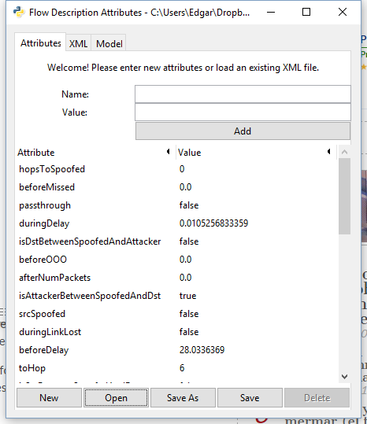
Attributes Tab - Open
Sample content loaded from xml file

Slide 8
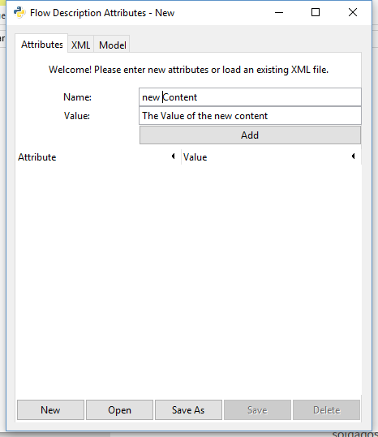
Attributes Tab – Adding Attributes
Content can be added after clicking the “New” button or loading existing attributes from an xml file using the “Open” button.
Finally pressing “Add”

Slide 9
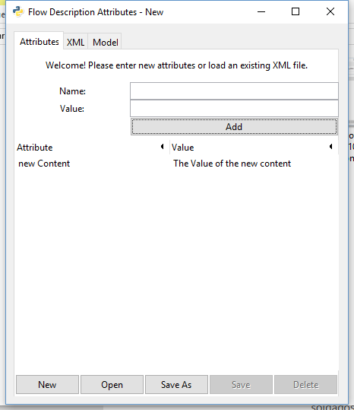
Attributes Tab – Adding Attributes
Sample new attribute added

Slide 10
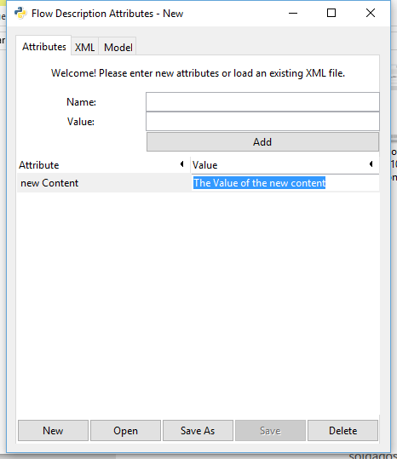
Attributes Tab – Editing Attributes
Double click the attribute’s value to be edited and just change it to the new value
Note: If a change is required to the attribute’s name, the attribute needs to be deleted and added again with the correction

Slide 11
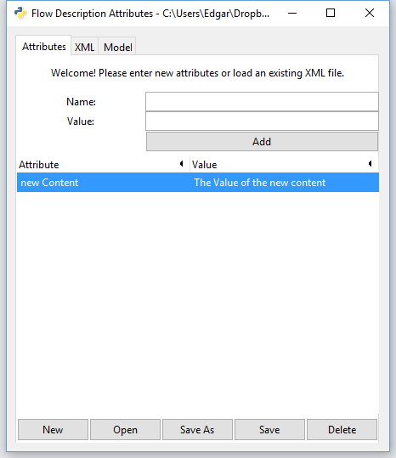
Attributes Tab – Deleting Attributes
Select the attribute to be deleted by clicking it.

Slide 12
Attributes Tab – Deleting Attributes
Select the attribute to be deleted by clicking it.
Finally, click the “Delete” button

Slide 13
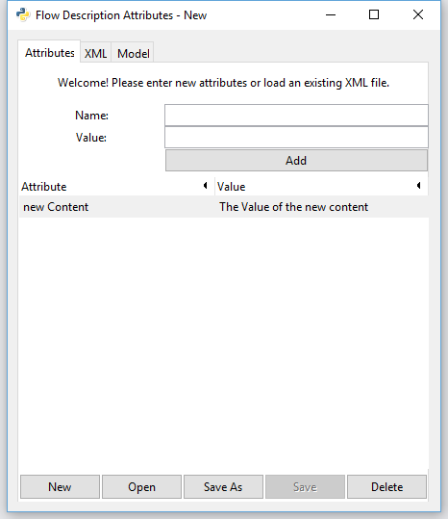
Attributes Tab – Save As
Click the “Save As” button.

Slide 14
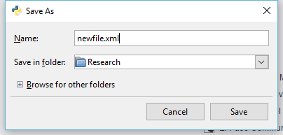
Attributes Tab – Save As
Click the “Save As” button, a dialog box will display.
Enter name for and extension (.xml) for file and select the location where it will be stored.

Slide 15
Attributes Tab – Save As
Click the “Save As” button, a dialog box will display.
Enter name for and extension (.xml) for file and select the location where it will be stored.
Click “Save” and the file will created.

Slide 16
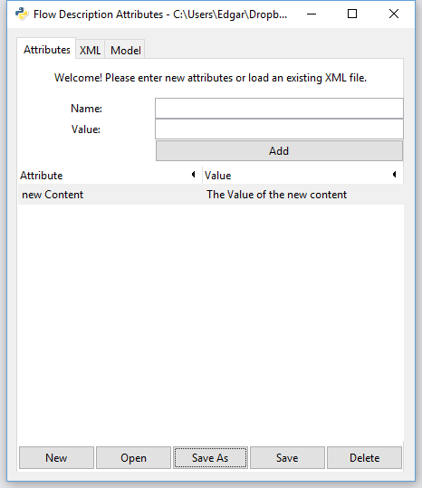
Attributes Tab – Save
Once you have loaded an existing file using the “Open” button or created a new one using “Save As”, the “Save” button becomes available for conveniently saving the file.

Slide 17
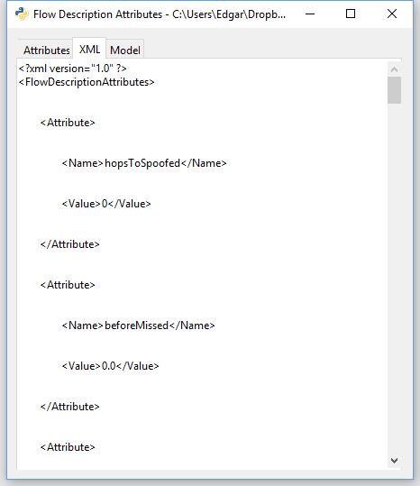
XML Tab
Once you have loaded an existing file using the “Open” button or created a new one using “Save As”, the xml can be observed the XML tab.

Slide 18
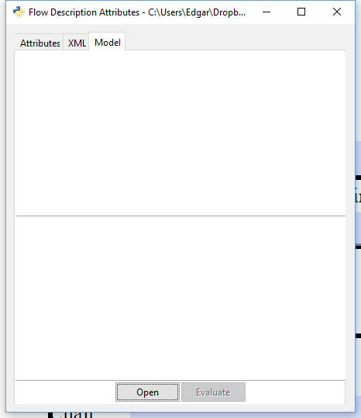
Model Tab – Open
Once you have created/loaded the attributes. Click “Open” to load a Python file containing the model to be evaluated.

Slide 19
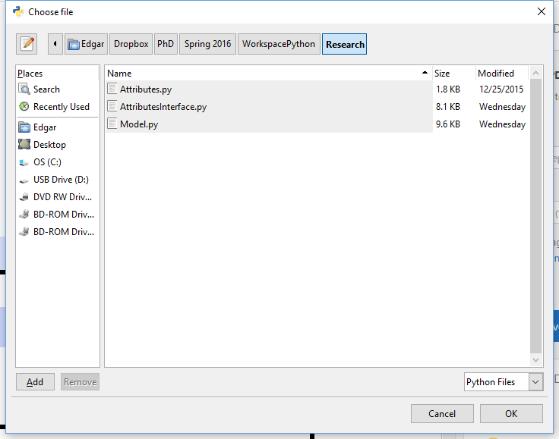
Model Tab – Open
Once you have created/loaded the attributes. Click “Open” to load a Python file containing the model to be evaluated.
Select Python files from the drop down box

Slide 20
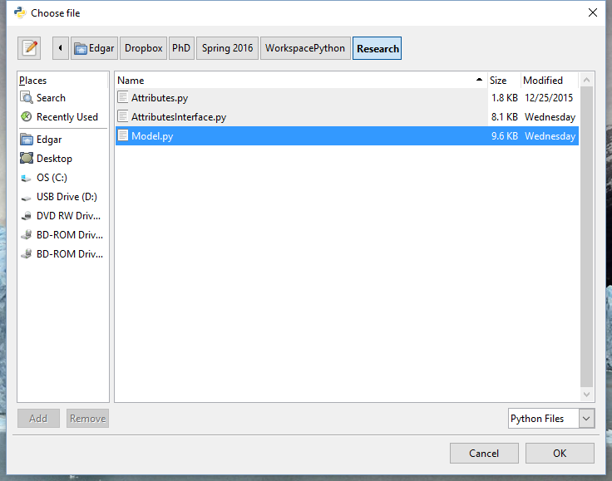
Model Tab – Open
Once you have created/loaded the attributes. Click “Open” to load a Python file containing the model to be evaluated.
Select Python files from the drop down box
Select the model file and click “OK”

Slide 21
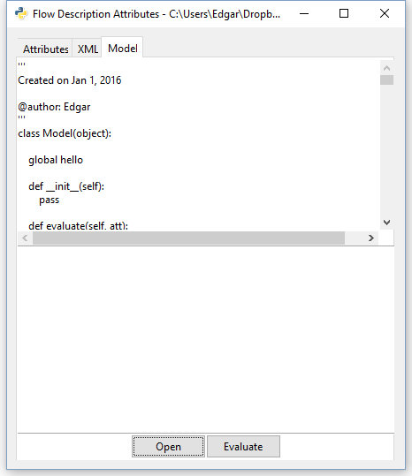
Model Tab – Open
Once you have model has been loaded. It will be displayed on the screen

Slide 22
Model Tab – Open
Once you have model has been loaded. It will be displayed on the screen
Click the “Evaluate” button to evaluate the model

Slide 23
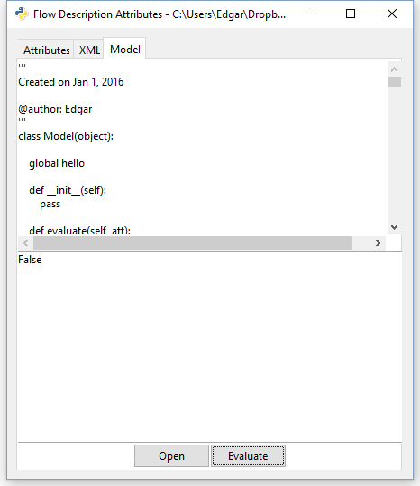
Model Tab – Open
Once you have model has been loaded. It will be displayed on the screen
Click the “Evaluate” button to evaluate the model
The GUI should display a true/false result

